Slide 1


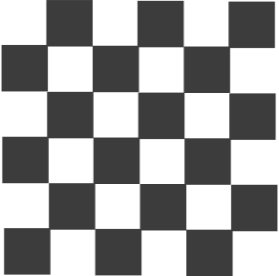
01
Mini Project 1
Correleation ANalysis between F1 Racing - Starting Grid position and Finishing Position Based on Mclaren Drivers Oscar Piastri and Lando Norris (2022-2024)
by Ryoko Suda
for IOD 17 Feb 2025 Cohort
7th May 2025

Slide 2

02
The Problem
As Formula 1 teams aim to maximize their performance, understanding the relationship between starting grid positions and finishing positions to score points.
We want to understand the importance of Qualifying high grid position to finishing position. And its consistency leads to improvement?
Goal:
We analyzed the performance of Piastri and Norris to see if starting higher in the grid (better starting positions) leads to better finishes and more points. This can provide insights into how well McLaren is performing in terms of driver development and race strategies. Understand the accuracy percentage

Slide 3

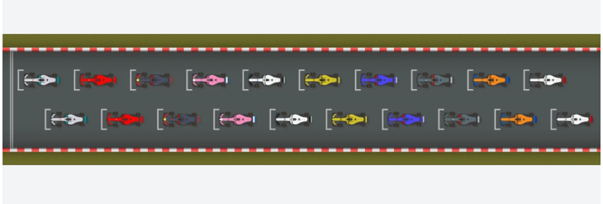
03
Hypotheses
"The better the grid position (closer to pole position), the more points a driver will score and the higher their finishing position in the race."
What is the accuracy percentage

Slide 4

04
What we analyzed
Data Points:
We looked at the data of Oscar Piastri and Lando Norris in the past 3 years, across 136 races. Their race qualifying results and finishing position in the actual race.
Driver Names: Focus on Piastri and Norris.
Grid Position: The position at the start of the race.
Position Order: The position the driver finishes in.
Points: Points scored based on finishing position
The data is downloaded from http://ergast.com/mrd/ and refreshed after each Grand Prix weekend. The data was originally gathered and published to the public domain by Chris Newell.
.

Slide 5
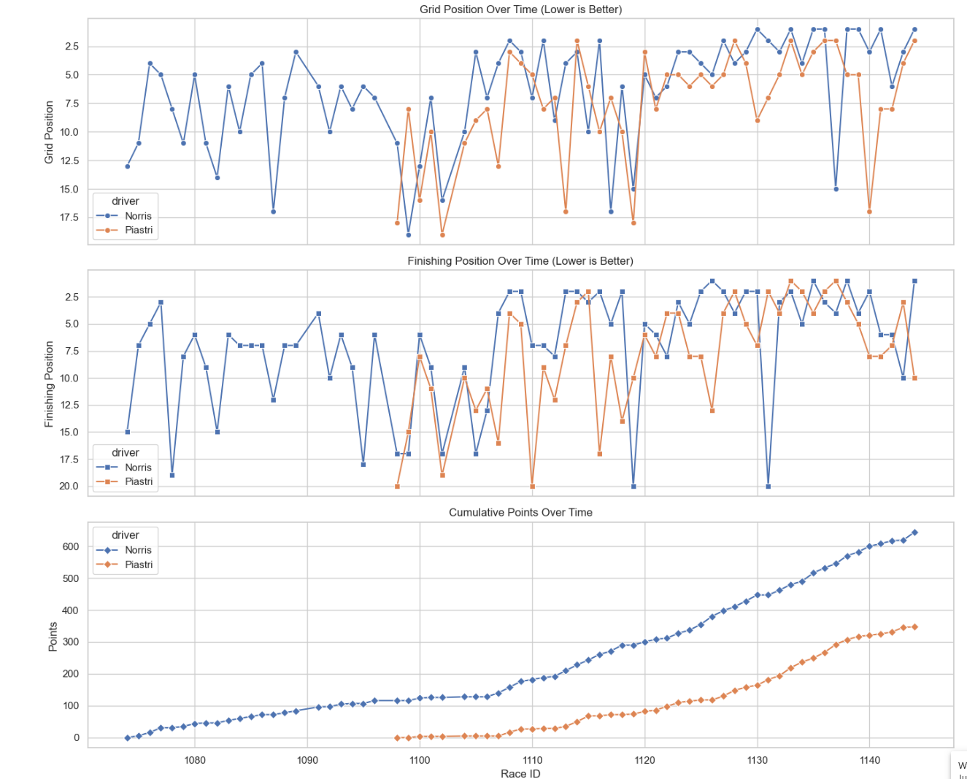

05
Statistical Findings:
Grid Position:
The analysis showed that drivers starting in better grid positions (closer to the front) tend to finish higher up and score more points. However, starting further down the grid leads to a decrease in points.
We can also see in this chart that the Mclaren Drivers Oscar Piastri and Lando Norris continious Grid Position Improvement in a trajectory of the past few years is upwards

Slide 6
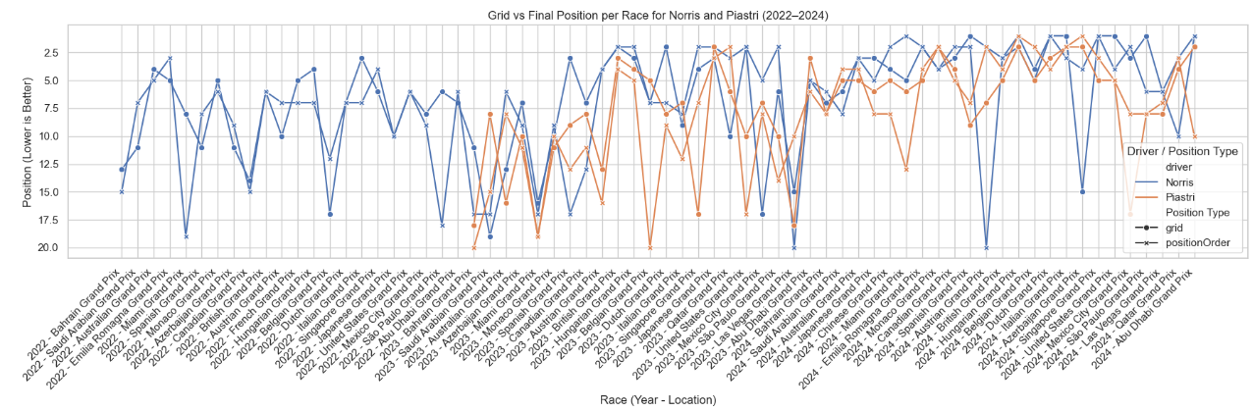
05

Slide 7
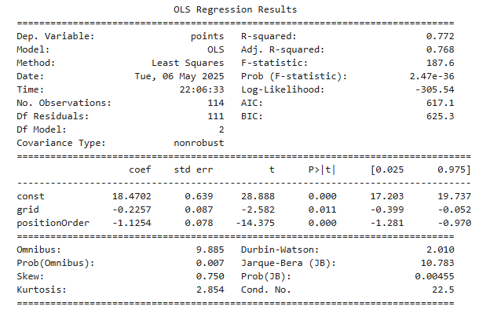
06
Correleation & Linear REgression
grid positionOrder
grid 1.00 0.65
positionOrder 0.65 1.00
Coefficient Correlation (Pearson's correlation)
0.65 is the correlation coefficient between grid and positionOrder.
This is a moderate positive correlation, meaning that the further back a driver starts (higher grid number), the worse they tend to finish.
A perfect positive correlation would be 1.0, and no correlation would be 0
Model Insights:
R-Squared Value (0.77): Our model explains about 77.2% of the variability in points based on the grid position and finishing position. This is fairly good however The residuals indicate some minor non-normality, but overall, the model seems to fit well. This may improve in adding more feautures
Significant Predictors:
Grid Position is significant—starting in a better position does matter

Slide 8
07
Summary of Results:
My analysis supports the hypothesis that better grid positions lead to higher finishing positions and more points for both Piastri and Norris.
Better grid positions mean higher chances of finishing in the top spots and scoring more points.
Takeaways:
The performance of McLaren’s drivers is heavily influenced by where they start. Improving grid positions can help McLaren increase their points and race results, which is crucial for their standing in the championship and there is upward trajectory in their years of performance
What could of we improved in this research (maybe Mini Project 2)
Investigate more into Lando Norris and Oscar Piastri’s Laptime per Race Track and maybe add weather conditions to see which driver does better.
Add more features to see if we still get the same results
If I apply the same methods in other teams will I still get 77% accuracy?

Slide 9


08
Lessons Learnt WHile DOing mini Project 1
The Business Problem you start with, is not what you end with as you do EDA.
I think I have done 7 revisions, trying out various merging techniques in EDA. I found dropping some columns helped in my heatmap and scatter plot
I feel I simplied it too much that in my next project I will add more variables to the model now that I feel abit more confident after going through so much EDA.

Slide 10


09
thank
you

